Slide 1
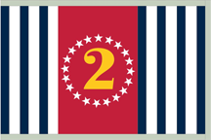
2019 D2 Spring Conference
ABC Class Changes
D/Lt/C Karl Wagner, JN-IN
D/1st/Lt Andrew Mark Cummings, JN
Notes:
Paul Mermelstein has shown what National is doing for the overall look of USPS, let’s review what can be done at the squadron level
Karl is helping you hold classes

Slide 2
What?
I never know what to write in a presentation. I just stare at a blank page and don’t know what to say.

Slide 3
Wrong!
What this slide says is wrong.

Slide 4
Wrong!
This is another slide with wrong things.
If you make a slide with wrong things, I can tell you what’s wrong with it – immediately, faster than I can type.
And of course, there is this voice (Susan Ryan) that says: “Add the branding to the bottom of the slide!”

Slide 5
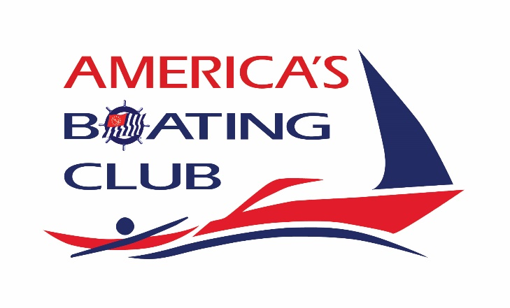
Changes in ABC

Slide 6
Changes in ABC
No CD for materials, download only
Local printing for:
Answer sheets ($1.00/each from catalog)
NASBLA tests 1A & 1B
Chapter 5 tests
State material integrated in menu
Update PFD material

Slide 7
Download Only
Login to www.usps.org, Educational Department, Curriculum,
America’s Boating Course (on left), America’s Boating Course
Look for “ABC3 Downloadable Materials page”
Or use this link: https://www.usps.org/index.php/departments/13000/13000-educational-committees/13170/13170-abc-downloadable-material
Also available on Google Drive for D2: https://drive.google.com/open?id=0BxFOfemNPOHnWHhYTG4tcmxqem8

Slide 8
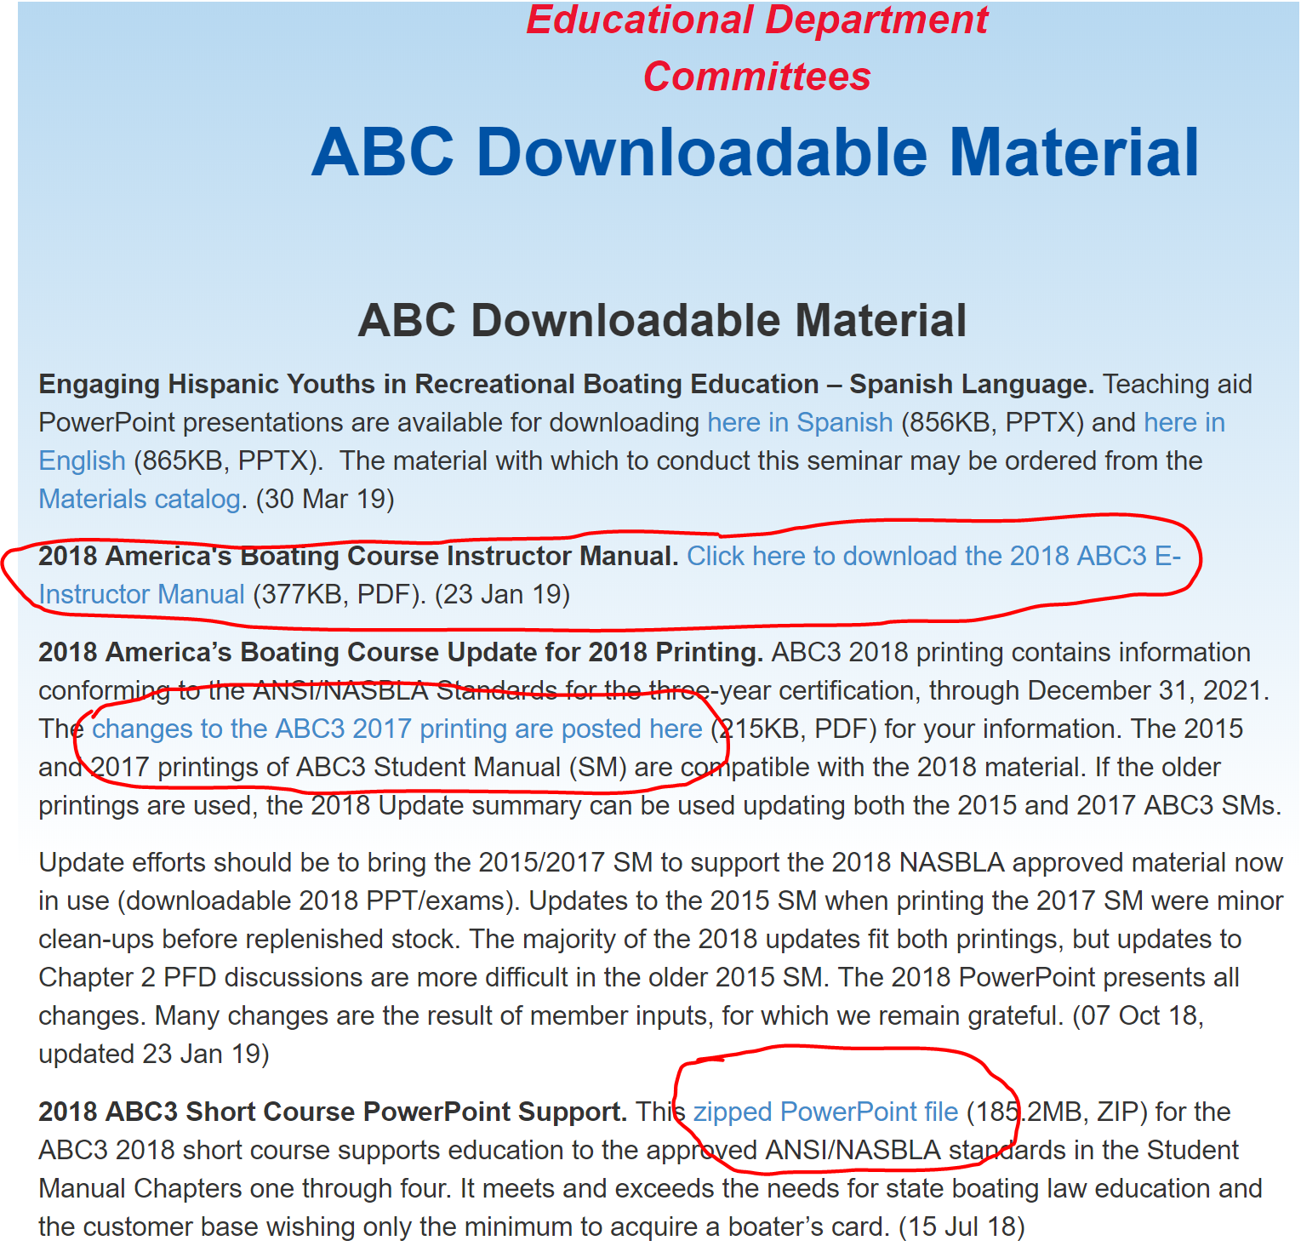
Download Only
Create a favorite or bookmark for future use
There is a new 2018 ABC Instructors manual (24 pages)
Errata sheet to use 2017 ABC books you have on hand.
No Errata sheet needed for 2018 ABC books
D2 Google Drive has all the material loaded – see prior e-mail for links

Slide 9
Local Printing
Things to print for class:
NASBLA 1A Exam – 50 Questions, most student pass the “A” exam
NASBLA 1B Exam – 50 questions, used when fail “A” exam (few copies)
State Exams – For Connecticut there are two exams, “A” and “B”
Answer sheets – Printing locally is less expensive than ordering
Exam answers – both NASBLA and State
ABC Instructor manual, if desired
For small classes, you may want to print on your local printer
For larger classes, you may want to print at FedEx/Kinkos (FedEx Office) or Staples or Office Depot. FedEx Office USPS Discounts:
http://theensign.org/wordpress/wp-content/uploads/2017/04/USPS-FedEx-Sign-Up-Instructions.pdf
http://theensign.org/wordpress/wp-content/uploads/2017/04/FedEx-Office-POLC-Catalog_Upload-and-Print_MOD_USPS.pdf

Slide 10
Local Printing
Sample Prices from FedEx Office (Kinkos):
Document | Copies | Cost/Unit
NASBLA 1A Exam | 30 | $3.44
NASBLA 1B Exam | 5 | $3.65
State Exams (CT) | 30 | $0.74
Answer sheets | 60 | $0.22
ABC Instructor manual | 5 | $9.22

Slide 11
State Material
Microsoft PowerPoint presentations use .ppt or .pptx for file extensions
Depending on Windows settings, you may or may not see the extension
A PowerPoint Show uses .pps and is the same as starting PowerPoint and using the “show” button on the bottom right or menu:
Save a PowerPoint presentation as “type show” (save as) and you create a PowerPoint Show
The ABC menus and presentations are PowerPoint shows
Section 8, the state material, is now integrated into the menu and therefore each state (New York, CT, Mass, etc.) has their own menu

Slide 12
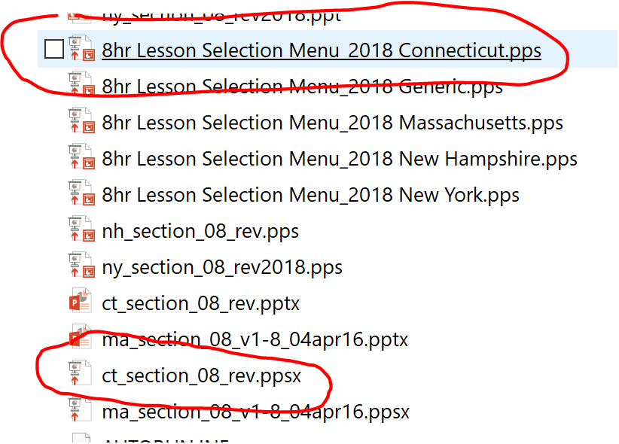
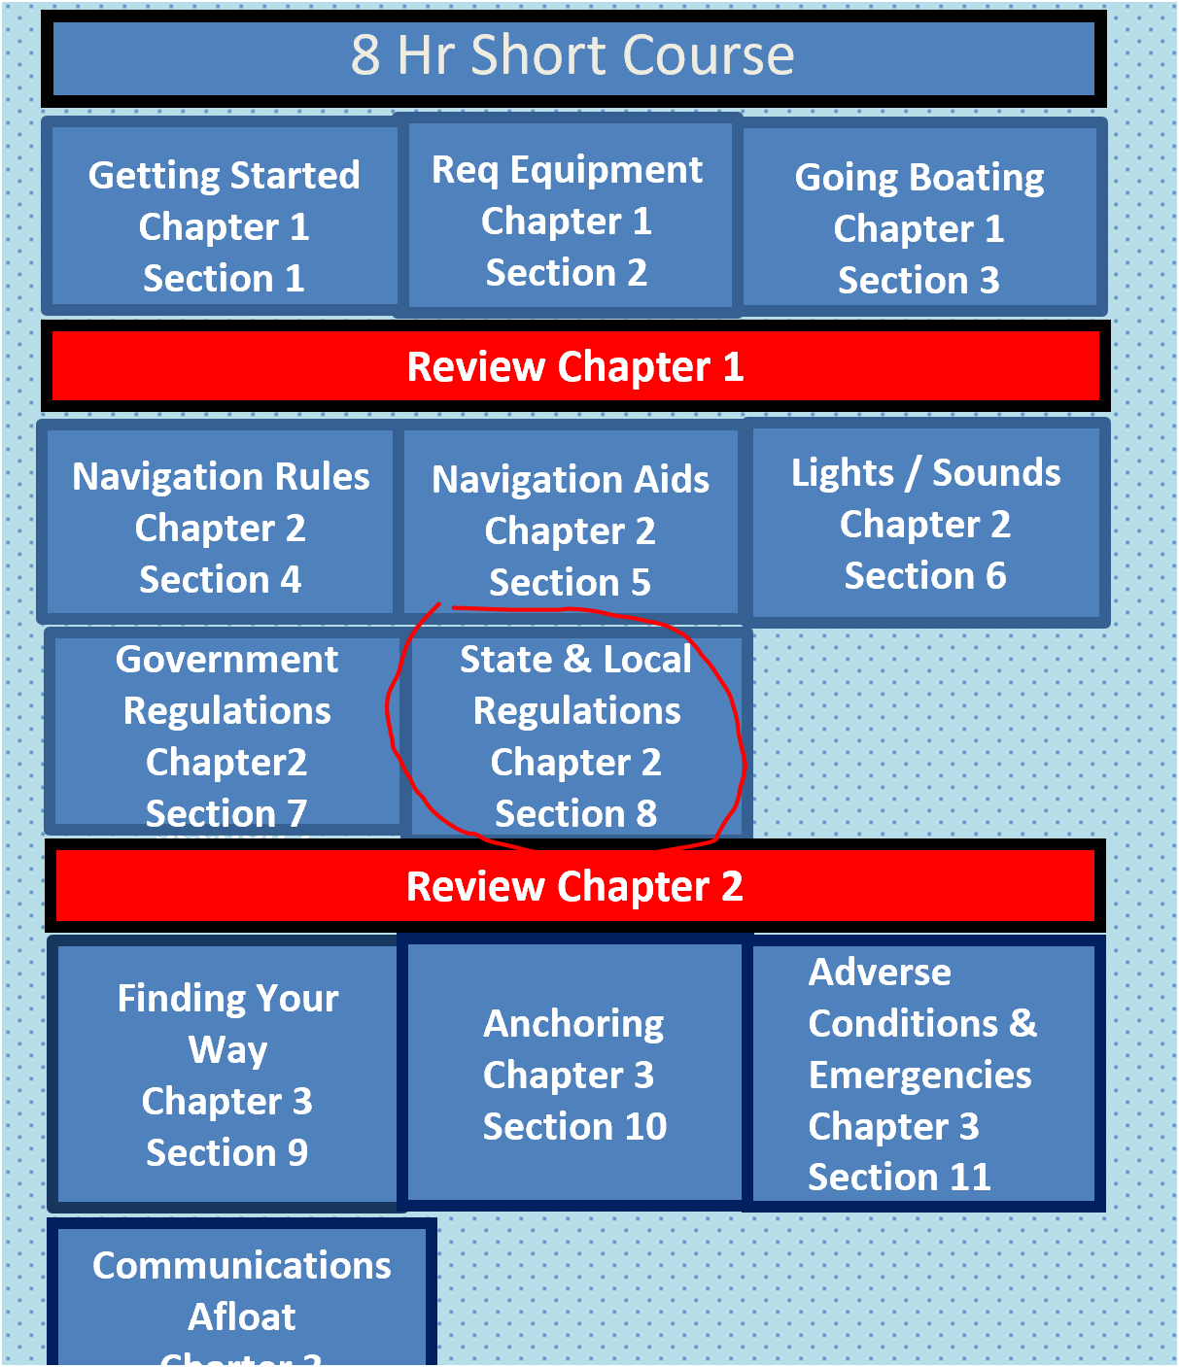
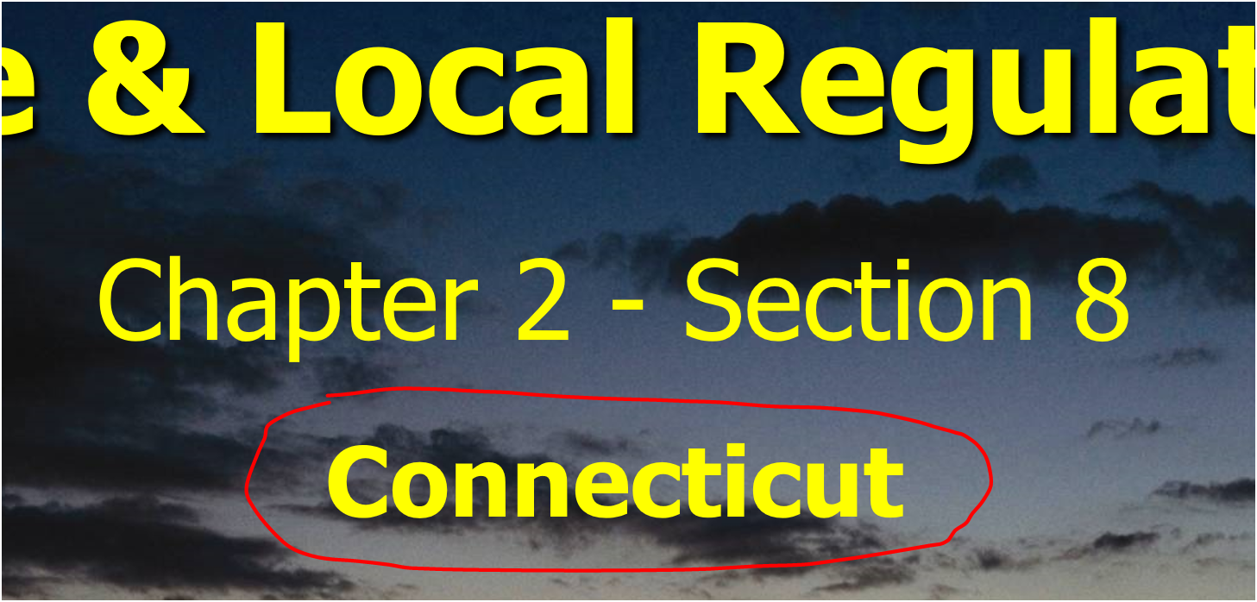
State Material

Slide 13
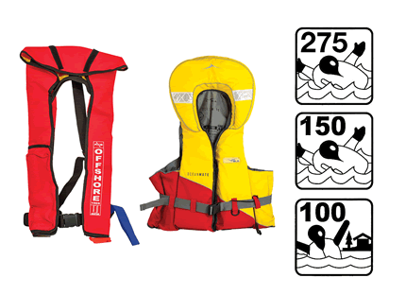
Lifejackets and Buoyancy Aids
PFDs are in two main classes.
Those which provide face-up in-water support to the user regardless of physical conditions = LIFEJACKETS
Those which require the user to make swimming and other postural movements to position the use with face out of the water = BUOYANCY AIDS
READ THE LABEL!
Notes:
Pages 20-24.
Make students aware of the two classes; lifejackets and buoyancy aids.
Emphasisze the variables and the need to carefully read the labels to be sure the buoyancy aid will meet the need of the boating adventure.
Coming terminology. Use of TYPE designation will continue for years, new is LEVELS. Think of the differing LEVELS: greater exposure to increasingly rougher seaway means a higher number PFD to provide more buoyancy to lift the head higher in the water.

Slide 14
Lifejackets and Buoyancy Aids
Primary function is to support the user in reasonable safety in the water.
Alternative attributes within the two classes:
Higher levels of support float higher
Levels 100, 150, or 275
Lighter or less bulky PFDs
Levels 50 or 100
Provide kinds of flotation for needs
Buoyant foam, hybrid and inflatable
Reliability, durability and continuous wear
Provide automatically buoyancy or inflate
Provide user control to inflate
Assist in detection for recovery of user
Notes:
The “Level” indicates how far the device will float your mouth and nose above the water. Much like the Type I for open ocean, level 150 to 275 will meet the need.
It appears but not yet stated by the USCG that the new Levels may be compared to the old TYPEs as:
Level 100 to 275 = formerly known as TYPE 1
Level 50 = formerly known as TYPE II
Level 50S = formerly known as TYPE III

Slide 15
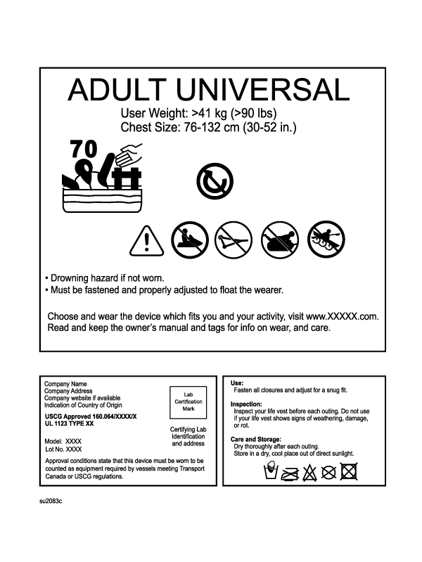
Life Jacket Requirements
USCG Approved Life Jackets
ARE REQUIRED
One for each person
Correct size - fit
Serviceable / Label
Readily available
Children must wear
Designed for activity
PFD = Personal floatation device =
LIFE JACKET
>>
Notes:
Paragraph 4-14
Figures 2-2 to 2-6
Tables 2-1, 2-2,
This label is new in 2018. Will help when choosing a life jacket.
Two panels – Selection and warnings panel
Certification, approval, care and maintenance panel
One USCG-approved wearable life jacket is required for each person on board. Label must be readable, provides details. READ THE LABEL. Older USCG approved PFDs in serviceable condition continue to meet USCG requirements.
When selecting a life jacket, SIZE is the most important consideration.
Children under 13 years must wear. Children sizes determined by user weight. States may prescribe different age requirements.
A life jacket with a rip or tear is NOT SERVICEABLE. Replace it.
PFD includes both lifejackets and flotation aids. Terms are used interchangeably throughout the course.

Slide 16
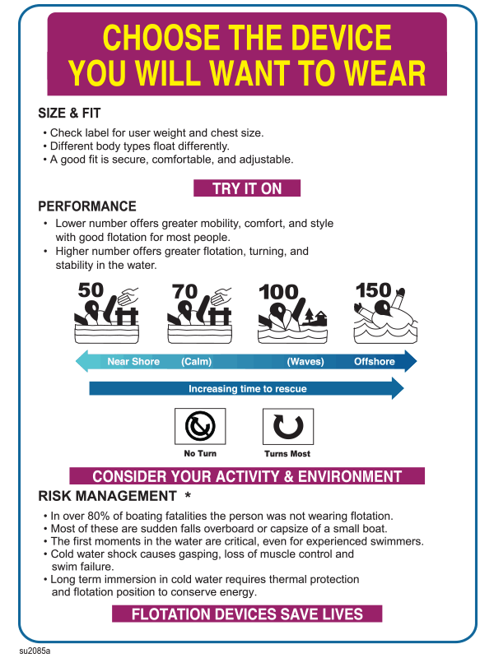
Life Jacket Label 2018
Information about size and fit
Explains the performance attributes and icons
Water safety information for the reader
Notes:
Check label for user weight and chest size. A good fit is secure, comfortable and adjustable.
Lower number offers greater mobility, comfort and style. Protected waters.
Higher number offers greater flotation, turning, and stability in the water. Open ocean,
Note the “No Turn” and “Turns Most” icons.
You are the risk manager!
In over 80% of boating fatalities the person was not wearing flotation
Most of these are sudden falls overboard or capsizing of a small boat
The first moments in the water are critical, even for experienced swimmers
Cold water shock causes gasping, loss of muscle control and swim failure
Long term immersion in cold water requires thermal protection and flotation position to conserve energy
Wear it!

Slide 17
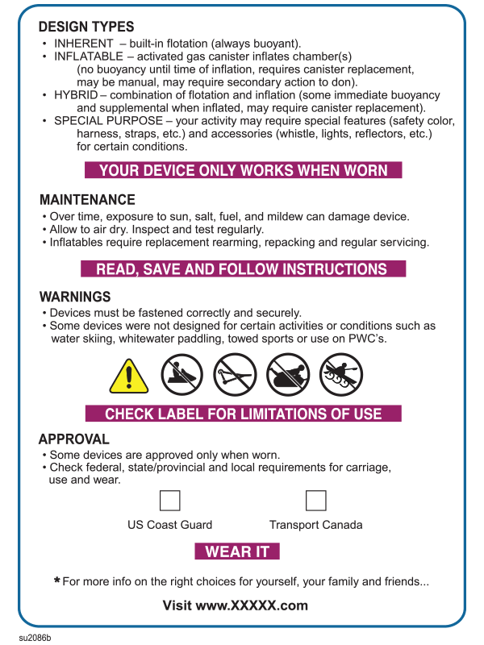
Life Jacket Label 2018
Explains the different design types
Maintenance
Warnings with explanations of icons
Regulatory Approvals
Website for more information
Notes:
Design types:
Inherent – built in flotation (always buoyant)
Inflatable – activated gas canister inflates chambers (no buoyancy until time of inflation, requires canister replacement, may be manual, may require secondary action to done)
Hybrid – combination of flotation (some immediate buoyancy and supplemental when inflated, may require canister replacement)
Special Purpose – your activity may require special features (safety color, harness, straps, etc.) and accessories (whistle, lights, reflectors, etc.) for certain conditions
Maintenance:
Over time, exposure to sun, salt, fuel, and mildew can damage device.
Allow to air dry, inspect and test regularly
Inflatables require replacement rearming, repacking and regular servicing
Warnings:
Devices must be fastened correctly and securely
Some devices were not designed for certain activities or conditions such as water skiing, white water paddling towed sports or use on PWCs
Approval:
Some devices are approved only when worn
Check federal, state/provincial and local requirements for carriage, use and wear
Website:
For more info on the right choices for yourself, your family and friends

Slide 18
Wear a Life Jacket
Before leaving the dock
Distribute, try-on and adjust straps
Conduct lift test to ensure fit
WEAR IT! If not, label and keep close
Attach whistle and light
First sign of any trouble – wear it. Putting on in water is difficult.
Notes:
Paragraph 5 - 9.
Lift test paragraph 46.
The skipper is responsible for this action, one that can save lives.

Slide 19
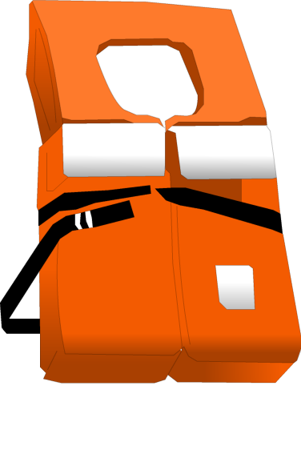
Off Shore Life Jacket
Open Ocean Area Operations
Elevates head
Designed to turn wearer face-up
For emergencies
Big and bulky
>>
Notes:
Label Figure 2-2
Lifting buoyance table - Table 2-1
Turn face-up paragraph 15
Off shore PFD para 10-15
Classes of PFDs
The five types of PFDs fall into three classes
based on their method of buoyancy:
1. Inherently buoyant
2. Inflatable
3. Hybrid inflatable
The buoyancy of a PFD, rated in pounds, is what keeps you afloat. Your weight is not the only factor in finding out how much “extra lift” you need in the water. Body fat, lung size, clothing, and whether the water is calm or rough all play a part in staying afloat. In general, the more physically fit you are, the more “lift” you need since muscle is heavier than body fat.

Slide 20
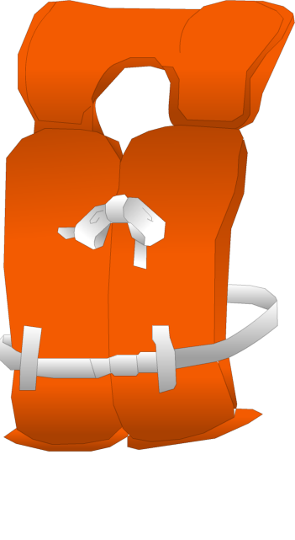
Near Shore Buoyant Vest
Semi-protected and Inland Operations
Elevates head
Roll most wearers face up
Part of USCG kit
Inflatables available
Child life jacket is
selected by matching
weight of child to life
jacket capacity on label
>>
Notes:
Paragraphs 16-20
Lift capacity Table 2-1

Slide 21
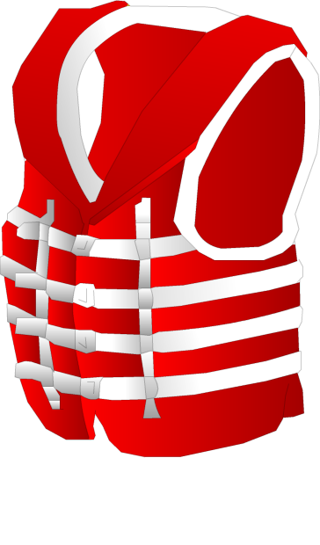
Flotation Aids
Buoyant Device
Many uses - popular
Many styles
More comfortable
Doesn’t elevate head
NOT designed to turn
wearer face up
Use for high speed, tubing, personnel towing
>>
Notes:
Para 21-25
EMPHASIZE THE FACT THAT THIS TYPE OF FLOTATION DEVICE WITH NEAR EQUAL AMOUNT OF MATERIAL IN FRONT AND BACK DOES NOT NECESSARILY TURN AN UNCONSCIOUS WEARER FACE UP.
Figure 2-3 and Sidebar
Discuss impact rated is stated on the label to the speed tested.

Slide 22
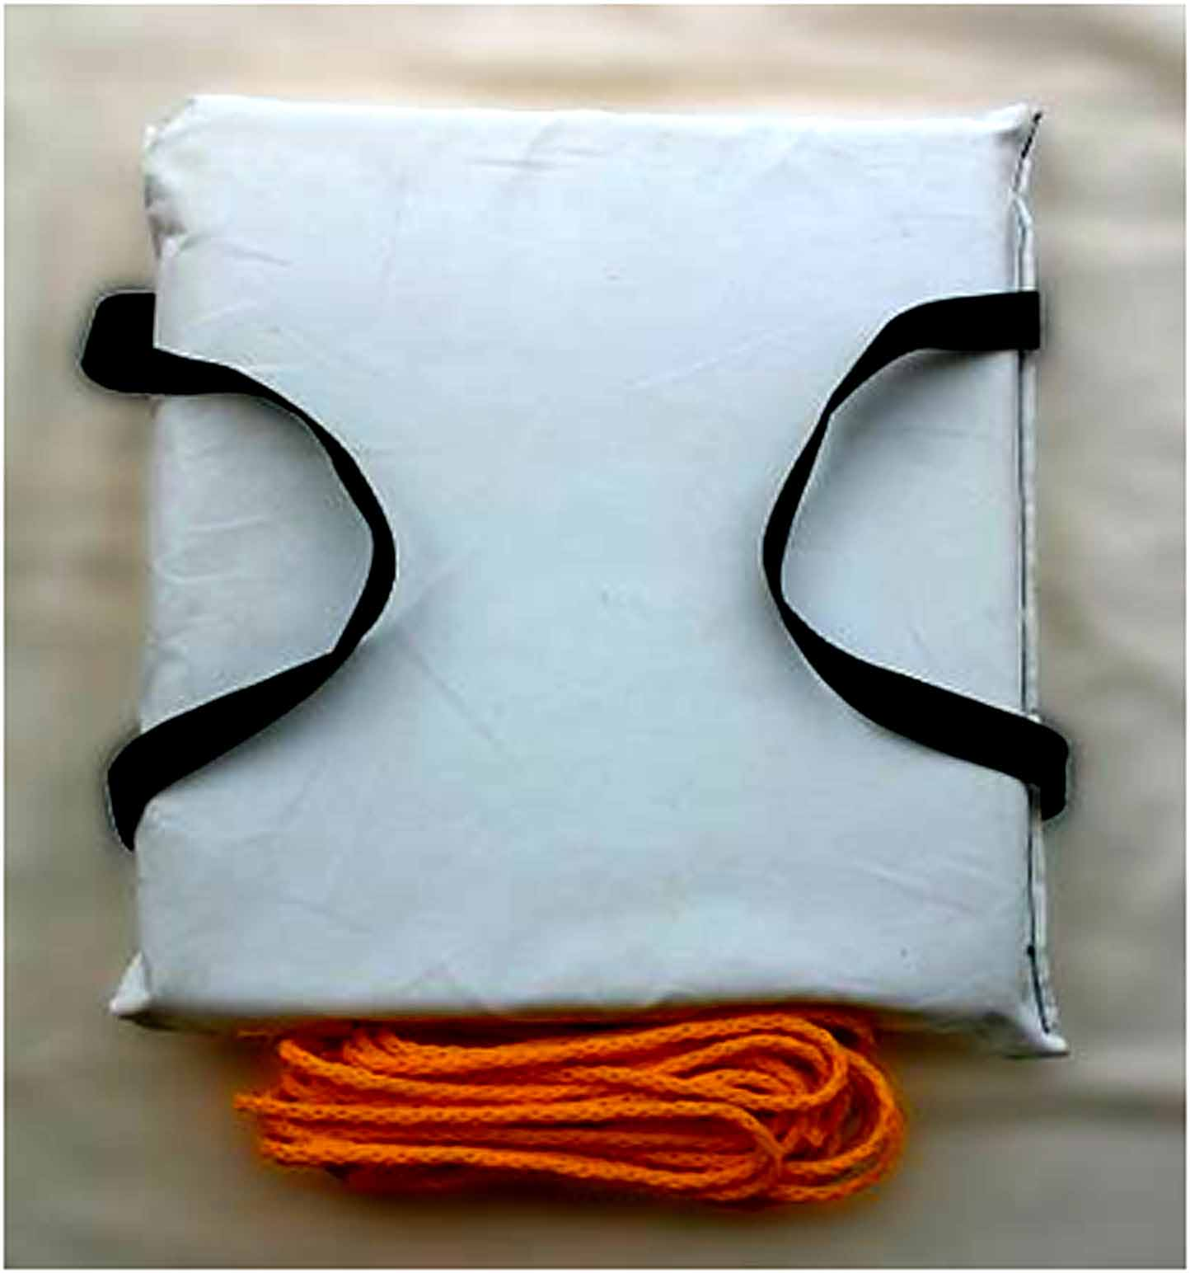
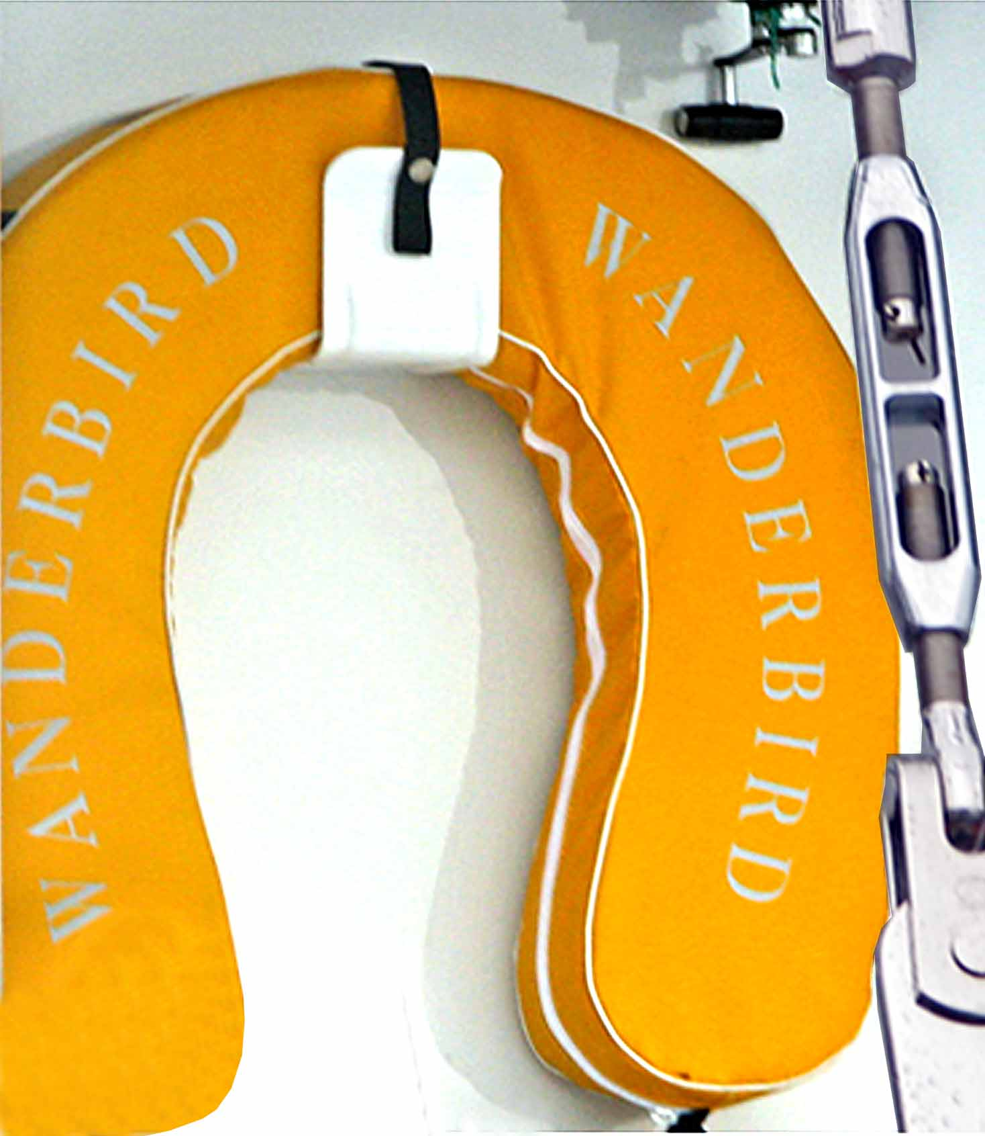
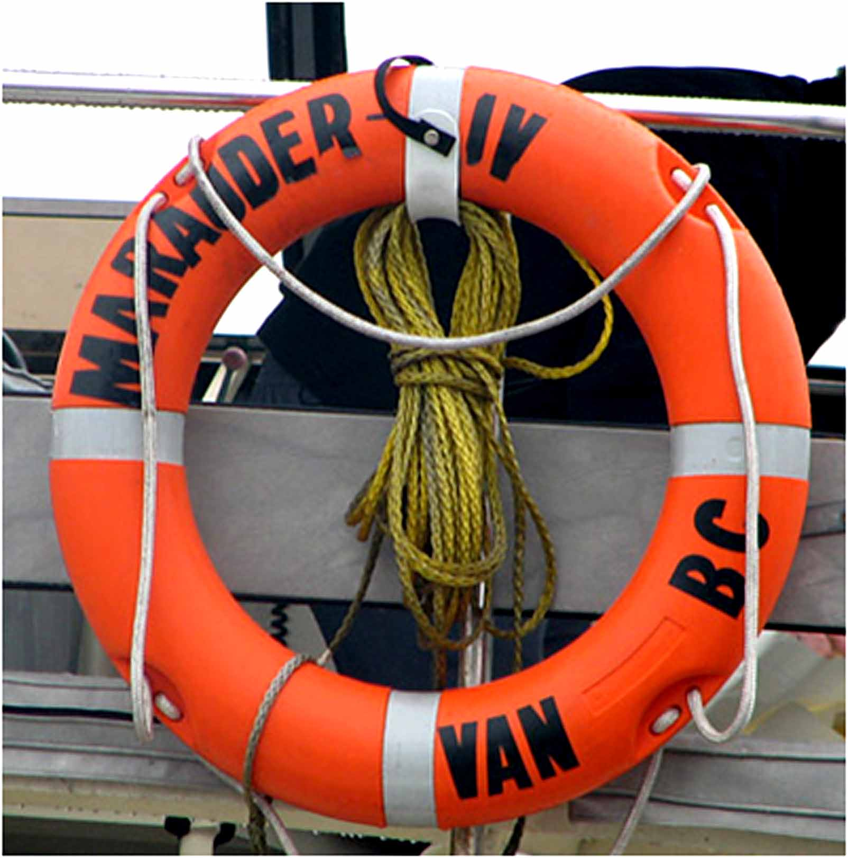
Throwable Flotation Device
Required on boats 16 feet and longer
(Except – Canoes and Kayaks)
Cushion
Life Ring
Horseshoe buoy
Type IV
>>
Notes:
Para 26-30
Thrown to person overboard
Any boat 16 feet or longer (except canoes and kayaks) must carry one throwable (Type IV)
Suggest tying polypropylene line to throwable device to assist in retrieving person who has fallen overboard.

Slide 23
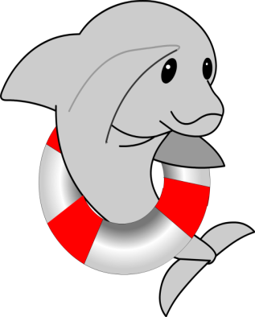
Special Use Life Jackets
Inflatable Life Jackets
ZERO buoyancy unless inflated
Inflated manually or automatically
Requires regular maintenance
Meets most requirements
NOT to be used for:
Weak or non-swimmers
Persons under 16 or under 80 lbs
High speed sports or under clothing
23
>>
Notes:
Para 31-41 Table 2-1 for lift capacities.
Inflatable PFDs
They may be inflated orally or with CO2, depending on the style. If the CO2 cartridge is used to inflate the life jacket, the CO2 bottle must be replaced to re-arm the life jacket for use. Always check the CO2 bottle integrity before boating.
Inflatable PFDs must have a full cylinder, and all status indicators on the inflator must be green, or the device is NOT serviceable and does NOT satisfy the requirement to carry PFDs.
Coast Guard approved inflatable PFD’s are authorized for use on recreational boats by persons at least 16 years of age.

Slide 24
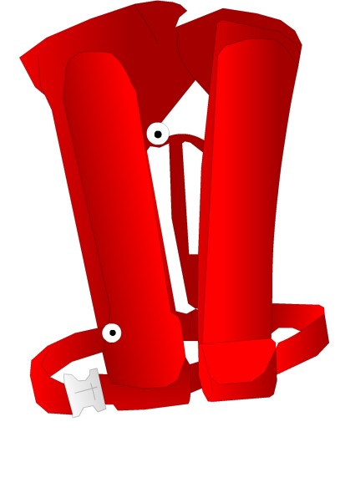
Special Use Life Jackets
Comfortable / Practical
Manual or Auto-Inflate
Buoyant suits
Sailboat harness
Hybrids
Replace used CO2
cartridge
>>
Notes:
Para 31-41
The auto-inflation feature is great – you may be unconscious and it will still inflate. The inflation mechanism is well protected from rain and spray; it requires submersion to activate.

Slide 25
Special Life Jackets for Special Boaters
See page 25 – Table 2-2 For Selection
>>
Notes:
Child PFD Requirements
In addition to Federal requirements, states require
that children wear PFDs, and some state requirements
supersede the Federal requirements. The requirements:
• Apply to children of specific ages
• Apply to certain sizes of boats
• Apply to specific boating operations

Slide 26
Must be Serviceable
Inspect all zippers & straps
Replace if ripped or torn
USCG approval label must be readable
Replace after extended exposure to water or weather
Check cartridge on inflatable PFD
Test inflation for 24 hours
IF ALL OK = SERVICEABLE!
>>
Notes:
Paragraph 63-82
A life jacket with a rip or tear is NOT SERVICEABLE. Replace it.
Emphasize the difficulty of putting on a life jacket while in the water because the life jacket is very buoyant.

Slide 27
Questions?

